Slide 1

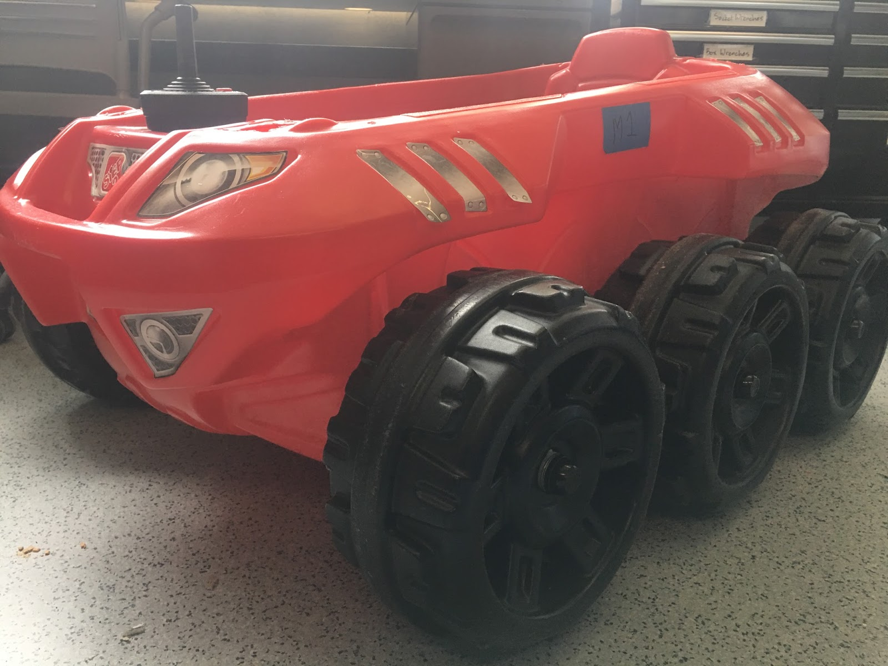
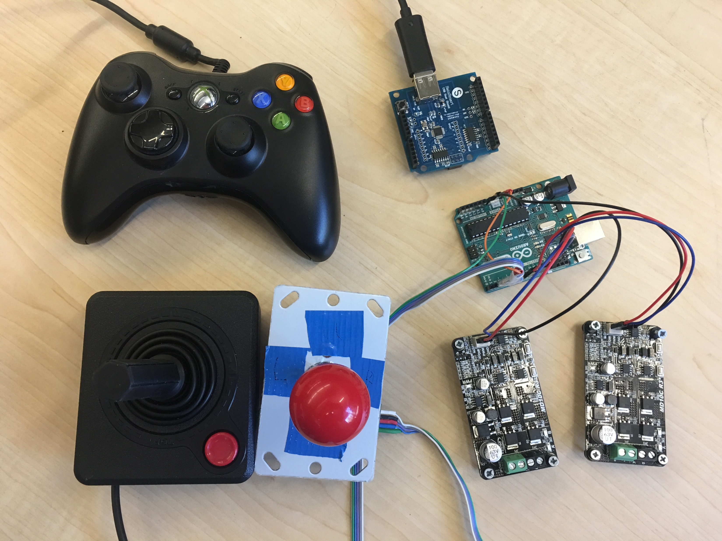
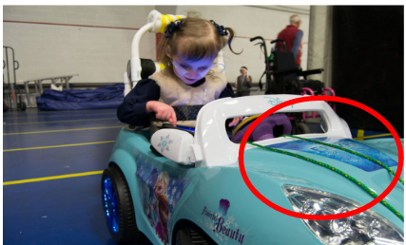
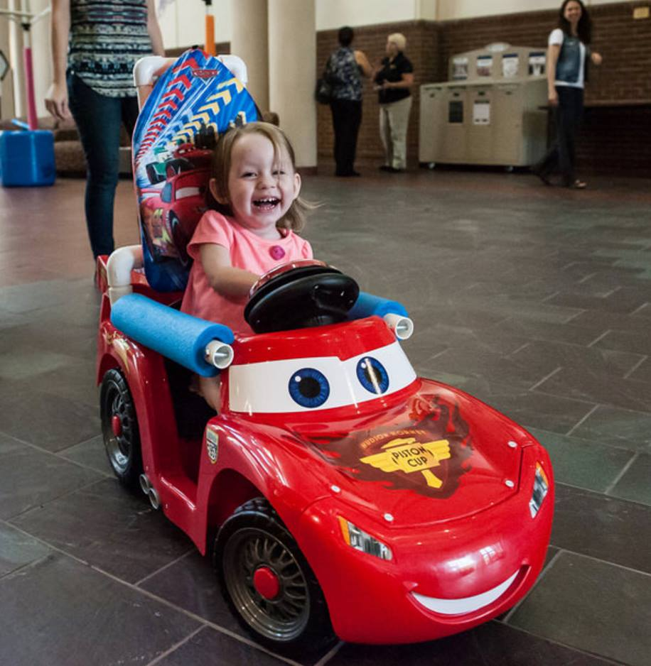
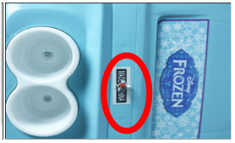
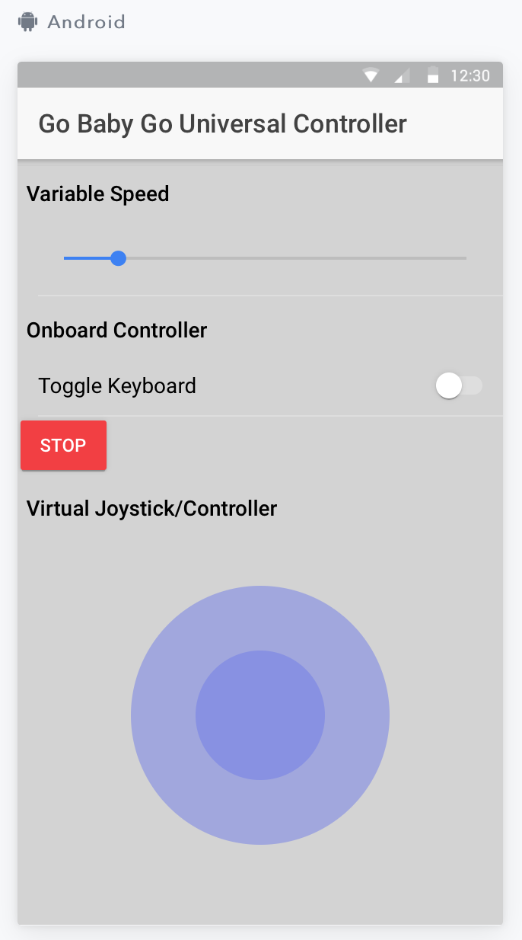
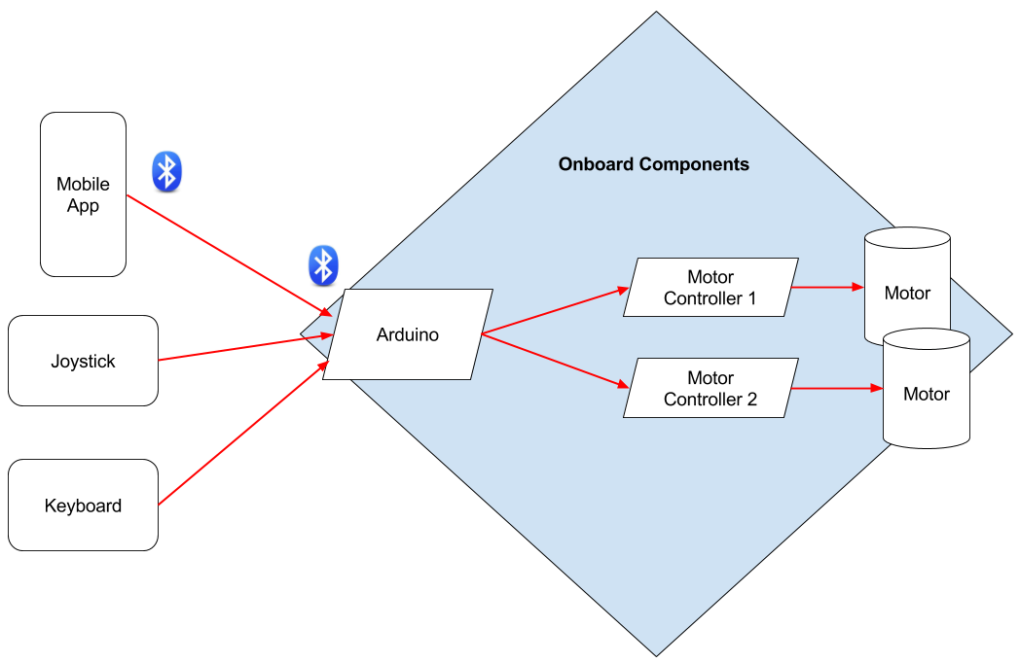

Go-Baby-Go Universal Control
Colter Hooker, Luke Lockard, Taylor Tackett, Leia Trice, Alex Thomas, Clare Willis
Sponsor: Dr. Sarah Oman Mentors: Dr. Maggie Vanderberg, Dr. Kyle Winfree
School of Informatics , Computing, and Cyber Systems
Abstract:
Xbox Controller
Arduino USB Shield
Solution Overview:
For typical children natural growth of independent exploration begins with the skill of crawling. Many children with disabilities, however, are often unable to independently explore their world because of limited mobility. Although child-sized electric wheelchairs are available to help address this problem, the cost is prohibitively expensive. The international Go-Baby-Go project aims to develop inexpensive solutions to close this “Exploration Gap” (i.e., the difference between the natural exploration ability of typical children and that of children with mobility issues). Go-Baby-Go focuses on adapting relatively cheap and easily available electric Ride-On-Toy-Cars with mechanical devices that allow children with mobility impairments to explore their surroundings via Ride-On-Toy-Cars. Our Computer Science Capstone Team B.A.M. (Babies are Mobile) has joined this effort. We focused on three challenges:1) steering control, 2) speed control, and 3) parental control.
We built a prototype system that accepts steering and speed control commands from multiple input devices: a keyboard, a joystick, Xbox controller and/or a mobile application. These devices interact with an Arduino to control the speed and direction of two motors. Our solution refines the motor acceleration and deceleration (so its not jerky), and allows for additional steering options, while providing the parent with optional complete control via the mobile app. This app allows the parent to override onboard controls-- including stopping the car, steering the car, and setting its max speed. Ultimately, we have developed a low-cost family-friendly solution that provides the children with mobility impairments safer options to independently explore their environment using our customized software solution and some basic hardware.
Our solution addresses the steering, speed and parental control problems through the following features:
The system was designed around multiple onboard input devices which gives flexibility to choose and easily install the best controller for the child.
The Arduino receives the input and directs the motors to ensure the car’s acceleration/deceleration is gradual and not jerky.
The Arduino allows a mobile application to be paired with the car via Bluetooth which gives the parents control over the car from a distance in order to keep their child safe, while giving the child freedom to explore
Ardunio Uno
Joysticks
Motor Controllers
Tools Used:
Figure 1: Picture of the Ride-On-Toy-Car we used
Figure 2: Example of onboard system components
Hardware used:
Arduino Uno (Figure 2)
MD10C motor controllers (Figure 2)
HM-10 (Bluetooth Adapter)
Atari 2600 Joystick (Figure 2)
Generic Joystick (Figure 2)
Xbox 360 Controller (Figure 2)
Arduino USB Shield (Figure 2)
Spin & Go Extreme Cruiser (toy car, Figure 1)
Software used:
Arduino IDE
USB Host Shield 2.0 library
Apache Cordova
Ionic Framework
Figure 3: Emergency stop
Figure 4: Ropes for parents to steer the car
Figure 5: Child using retrofitted car
Future Work:
Make the car more socially interactive for the child by developing a game that can be played while driving the car.
Allow for additional onboard controllers, such as a gyroscope which could make the child’s movements translate to car movements .
Create a repository so that all Go-Baby-Go chapters can share work and knowledge.
Problem Statement:
Mechanical Engineers have made significant contributions to the Go-Baby-Go project by mechanically altering Ride-On-Toy-Cars for individual children, but there are a few drawbacks.
Steering – Some of the children need a different steering mechanism rather than a typical steering wheel.
Speed – Existing vehicles can only travel at one speed (i.e., full speed), which creates a jerking motion as the car starts and stops. This can be frightening, and possibly dangerous to the child.
Parental Control – Currently, parents have no control over the vehicle unless they are close enough to hit the emergency stop switch (Figure 3), or use a rope to hold on to the car (Figure 4) .
Figure 6: Android Application
Figure 7: System architecture

